Slide 1
Semi-monthly to Bi-weekly payroll
Subtitle Here
Preparing for the change

Slide 2
Effective Date
Effective August 1, 2022, Lehigh University will move all non-exempt staff who are currently paid semi-monthly to a bi-weekly payroll.
This change will not affect exempt staff who will remain on a monthly payroll schedule.

Slide 3
Students
Change will begin with the new
Academic Year 2022-23 contract
Includes Research Assistants, Teaching Assistants, Graduate Assistants, Research Undergraduates, Gryphons, and TRAC Fellows.

Slide 4
Reason for change
This change will result in a clearly defined two-week work period that includes both regular and exception pay.
(overtime, vacation time, sick time, etc.)
This will end the confusion surrounding regular pay on one paycheck and overtime on another.

Slide 5
What action do I need to take?
Review your personal finances and determine if you need to adjust your budget for bi-weekly pay.
If you have recurring or automatic payments (for example, rent, mortgage, car loan, utilities, etc.), you should review your monthly finances to prepare for bi-weekly pay.
If you make a voluntary flat dollar amount retirement contribution, you may want to review these amounts as you will be receiving two additional pays throughout the year. Go to www.tiaa.org/lehigh or call TIAA at (800)-842-2252 for assistance.
The payroll calculator illustrates how the 2022 and 2023 calendar years will be paid

Slide 6
Pay schedule
You will be paid every other Friday, for the time reported in the previous pay period.
Bi-weekly pay periods run for two weeks beginning on a Sunday and ending on a Saturday.
Bi-weekly pay is 26 times per year, versus 24 pays on the semi-monthly schedule
Because there are two additional pays, Bi-weekly pay will be slightly less than your regular semi-monthly pay.
2022 and 2023 Bi-weekly Payroll Calendars here.

Slide 7
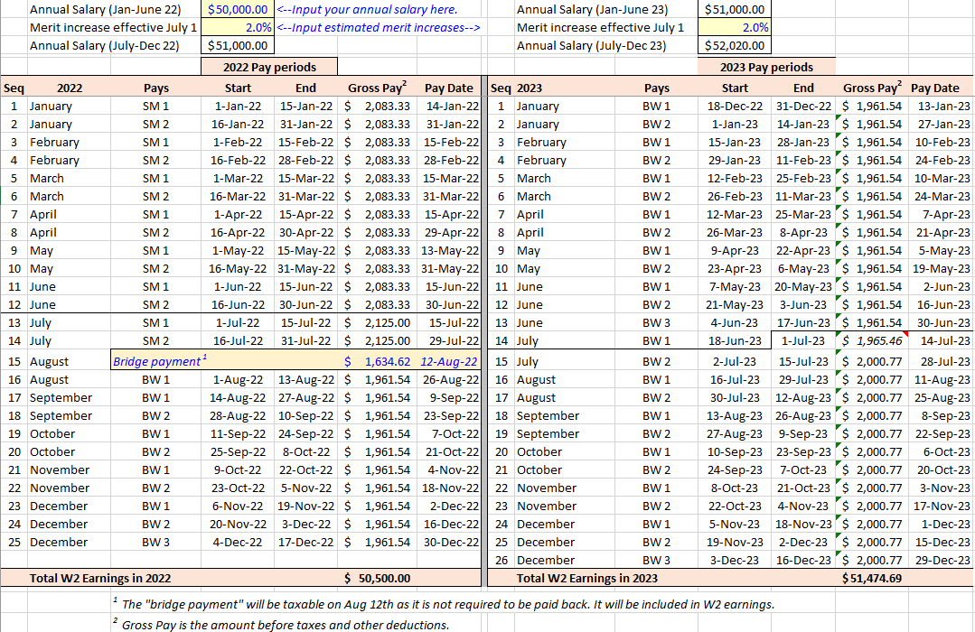
Payroll Calculator

Slide 8
Bridge payment
Subsidy offered by Lehigh to make 2022 W2 earnings whole
August 12th, 2022
One time only
No repayment necessary
2022 and 2023 Bi-weekly Payroll Calendars here.
Eligible employees are currently paid semi-monthly on continuous appointments.
Students on semester or academic year contracts are not eligible.

Slide 9
3.2%
Bridge
payment
of annual salary

Slide 10
Questions? See our FAQ
Email insm2bwq@lehigh.edu

