Slide 1

Uniform Guidance –
What Administrators and PIs Need to Know
Sections 2 CFR 200 “Uniform Administrative Requirements, Cost Principles, & Audit Requirements for Federal Awards”
Procurement Standards: Sections 317-326

Slide 2
Executive Summary
The Uniform Guidance (UG) governs the management of federally funded sponsored projects across the entire project lifecycle. Although much of the UG took effect on December 26, 2014, the government delayed implement of the procurement sections. Updated University purchasing policies implementing the UG went into effect July 1, 2018. The UG supersedes requirements form OMB Circulars A-21, A-110 and A-133.
This presentation highlights the Purchasing areas that are impacted by the UG relating to sponsored transactions.

Slide 3
Uniform Guidance
2 CFR Part 200: “The Uniform Administrative Requirements, Cost Principles, and Audit Requirements for Federal Awards” – referred to as the “Omni Circular” or “Super Circular”
Consolidates 8 previous federal regulations (A-21,A-50, A-87, A-89, A-102, A-110, A-122 and A-133) into comprehensive guidance via 2 CFR Part 200 (Subparts A – F) (Section 200.318 - 200.316)
New procurement policies effective July 1, 2018; applies to new awards made after that date
Transition year – will have grants governed by old guidance and some by new guidance
Statement that Lehigh is compliant with the new standard

Slide 4
Major Changes
What?
Purchasing methods
Procurement thresholds and standards
Documented policies and procedures to address the “must haves”
Why?
Strengthen oversight of Federal funds to reduce risk of waste, fraud and abuse
Streamline guidance for awards to ease administrative burden

Slide 5
Action Plan for Lehigh
Modify policies, processes and systems to satisfy requirements
Streamline processes to enhance compliance (purchasing checklist, bid summary form/bid matrix, etc.)
Grow policy understanding and compliance through communication and training
Utilize preferred suppliers or consortium suppliers to decrease administrative burden

Slide 6
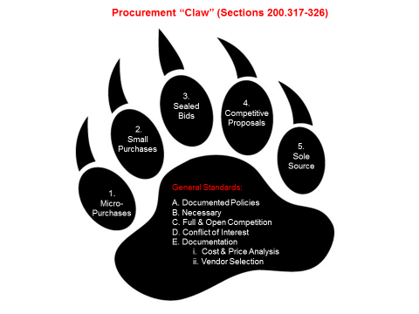
The Procurement “Claw”

Slide 7
5 Methods | Dollar Threshold | Requirements
Micro-purchase | $1 - $10,000 in aggregate | No hard quotes required Equitable distribution (spread the wealth vs your favorites)
Small purchase | $10,001 -$250,000 | Quotes required from at least 2 sources Informal - web price searches sufficient Price doesn’t need to be deciding factor, but all quotes must be kept in procurement record
Sealed bid | > $250,001 | Used when decision can be made principally on basis of price Publicly solicited proposals; multiple qualified sources Defined specifications Firm fixed price contract with lowest responsible bidder, written valid justification if not awarding to lowest bidder
Competitive proposal | > $250,001 | Must identify all evaluation factors and relative importance Publicly solicited proposals; multiple qualified sources Must document technical evaluations of proposals and selection decision Contract award to firm with best proposal – highest score
Non-competitive proposal/sole source | > $10,000 | May ONLY be used when available only from a single source, during public emergency, or if federal agency expressly authorizes sole source justification in writing Justification of the sole source must be documented and retained in procurement records Any initial solicitations from other sources deemed inadequate must be documented

Slide 8
Procurement Standards
Policy & Procedures Lehigh must have a purchasing policy and document adherence to the policy | Necessary Purchases made are necessary for operations and in an efficient manner | Full & Open Competition Vendors given equal consideration | Conflict of Interest Lehigh community must disclose conflicts of interest | Documentation For purchases above Micro Purchase threshold, must: - complete cost or price analysis - explain why vendor was chosen

Slide 9
Takeaways
Differentiate the allowable methods of procurement
Federal vs. State requirement – if state is lower, follow the more stringent threshold
When in doubt about policy/process interpretation, always call the federal awarding agency; because if/when you are audited, approval of the chosen approach must be in writing from the federal granting agency
UG documentation requirements are more significant
Any spend over $250,000 requires early Purchasing involvement
Changes will result in increased scrutiny for ALL sole source justifications. “Continuity of Research” is no longer an acceptable justification for sole source approval (see “hypotheticals” document for examples) and every sole source will require a documented price/cost justification
Understand that non-compliance can lead to:
    Negative audit findings
    Bad press – w/vendors and community
    Loss of funding

Slide 10
Questions?

